Slide 1

AIR QUALITY ANALYSIS
Kshitiz Bansal

Slide 2
Problem Statements
Yearly & Monthly Air Quality Analysis
Detailed State & City Selective Air Quality Analysis
Impact Of Covid-19 On Air Quality
Observing Harmful Gases Content Variation
State Ranking On Yearly Basis
Analysing AQI Scale Over Period Of Years

Slide 3
Agile Methodology
Defining Problem Statements
Plan
Performing ETL Operation
Develop
Data Model Deployment
Deploy
Verifying Data Transfer
Test
Reporting & Visualization
Review

Slide 4




Blueprint
Azure Data Factory
Azure Databricks
Azure Analysis Services
Power BI
Extracting Data
From External Source
(HTTP)
Cleaning & Transformation Operations
Establishing Internal Relationships & Data Model Deployment
Visualization & Reporting

Slide 5
Calculation Metrics/Parameters
Metrics & Dimensions
Data Parameters
City
State
Datetime
Geographical Location
Time Dimension
PM10
PM2.5
NO
NO2
NOx
NH3
CO
SO2
O3
Benzene
Toluene
Xylene
AQI
AQI Bucket

Slide 6
Extracting Data
Creating An Azure Data Factory Instance
Creating A Linked Service With HTTP Source (Kaggle)
Saving Extracted Data To Blob Storage
Creating A Databricks Notebook Activity
Mounting Blob Storage With Databricks Notebook
Reading Data Through Triggering Pipeline

Slide 7
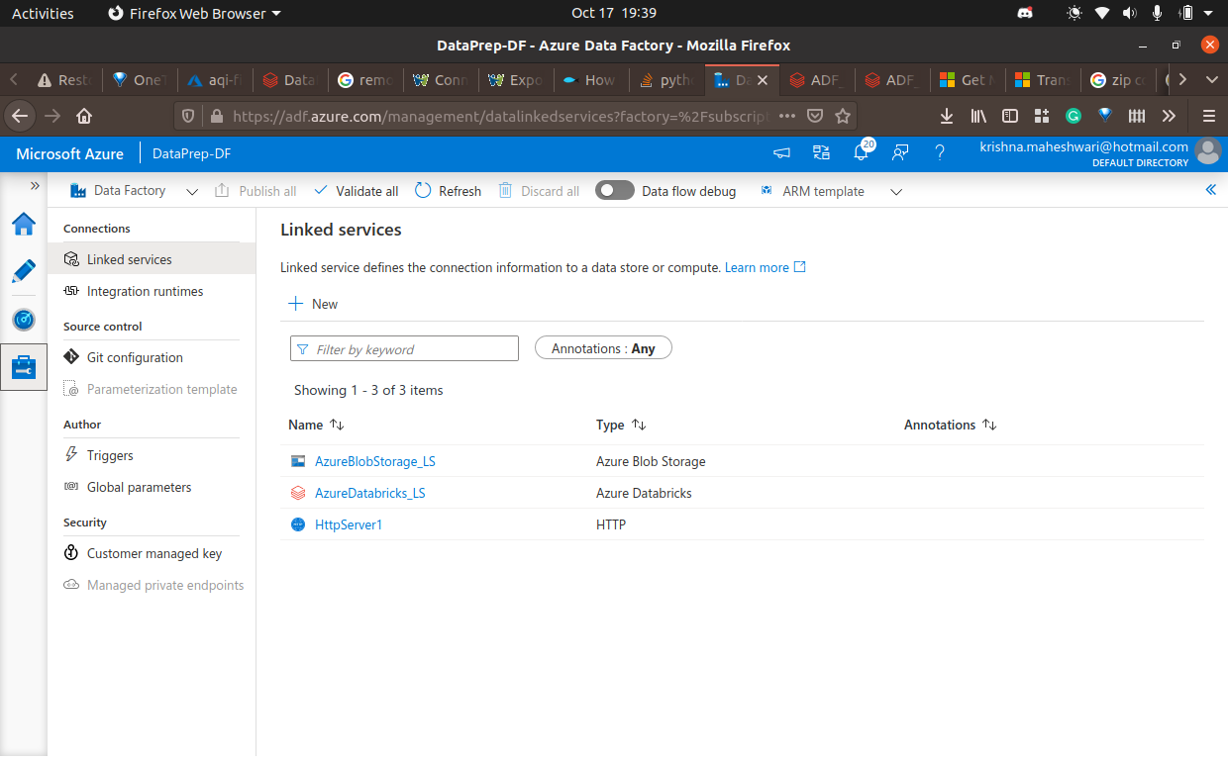

Slide 8
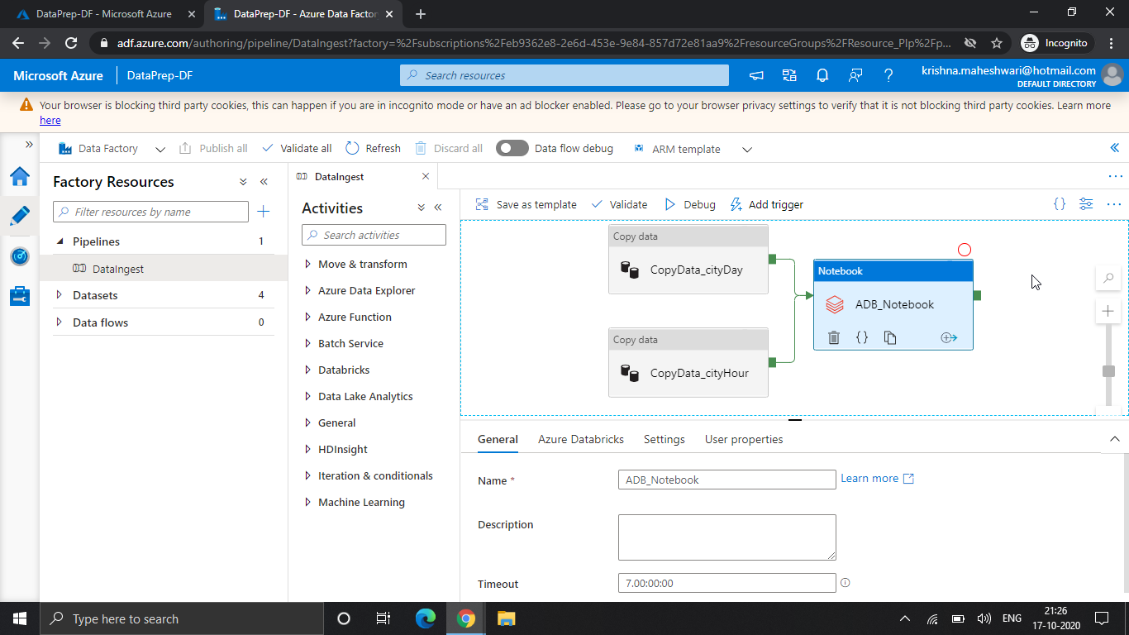

Slide 9
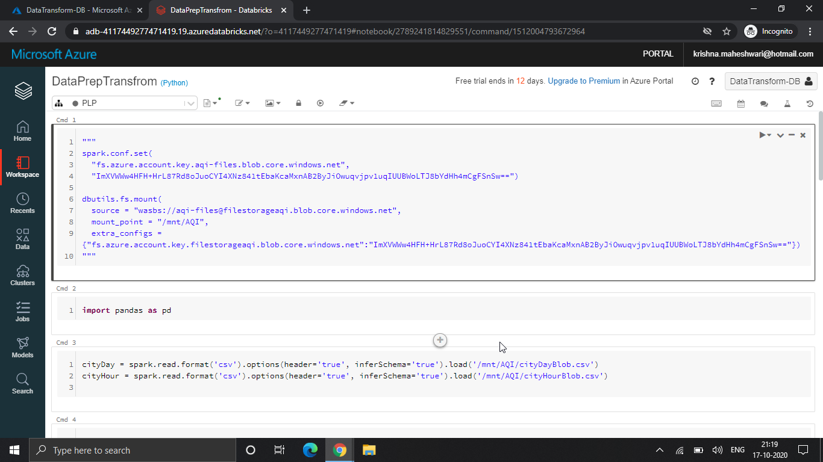

Slide 10
Data Transformation
Language Used
Python 3
Detecting Schema For Each Dataframe
Using Linear Interpolation To Handle Missing Values
Creating Desired Calculated Columns
Mounting Transformed Data Back To Blob

Slide 11
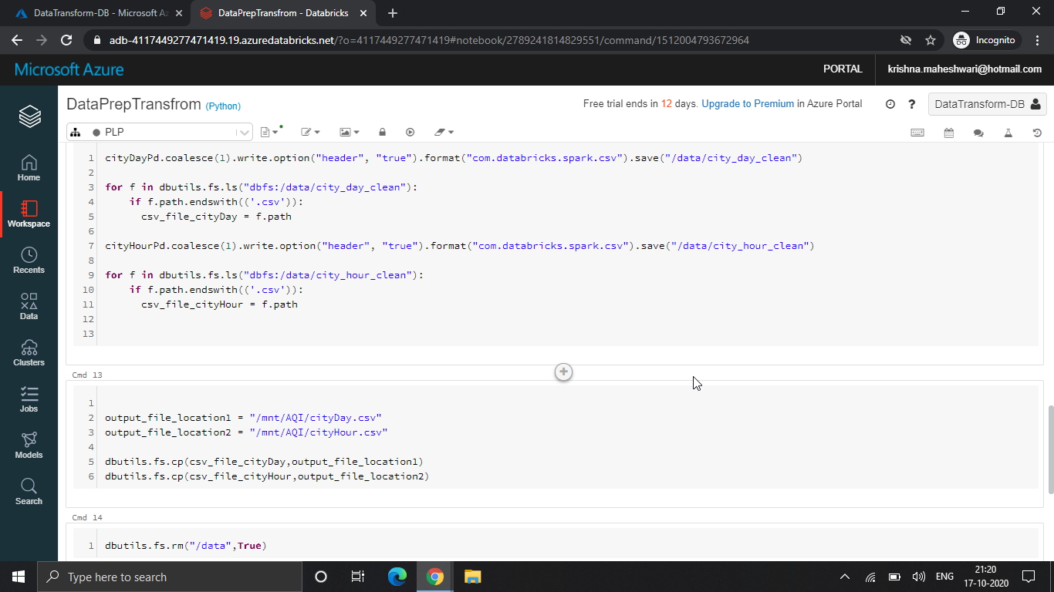

Slide 12
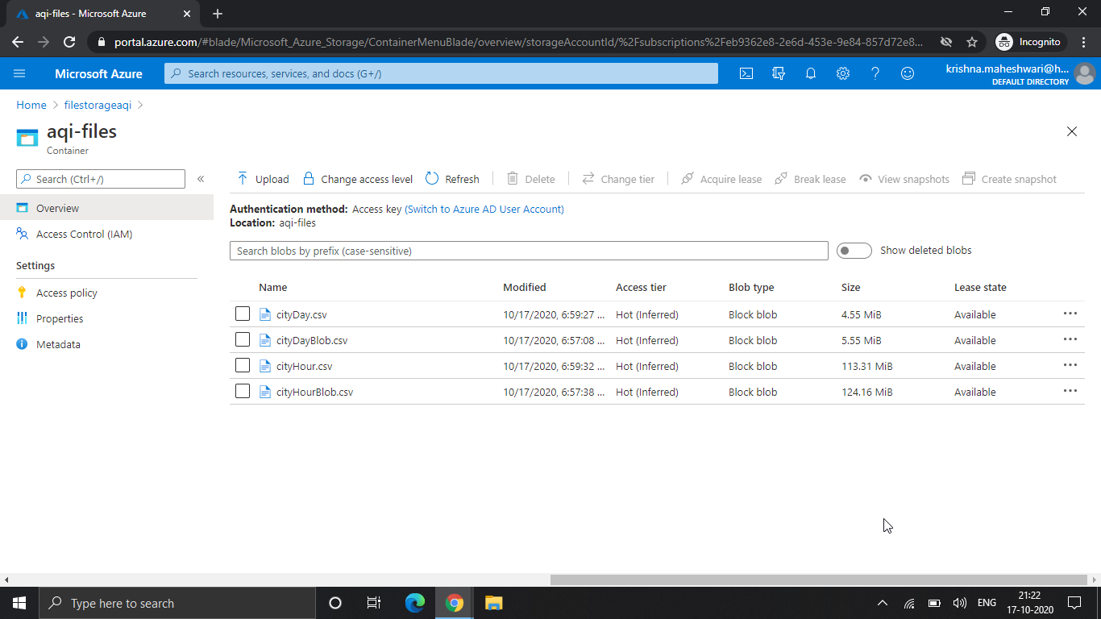

Slide 13
Data Model Deployment
Language Used
DAX
IDE Used
Visual Studio 2019
Importing Data Into Visual Studio Analysis Services Project
Establishing Internal Relationships Among Tables
Deploying Data Model To Azure Analysis Service Server

Slide 14
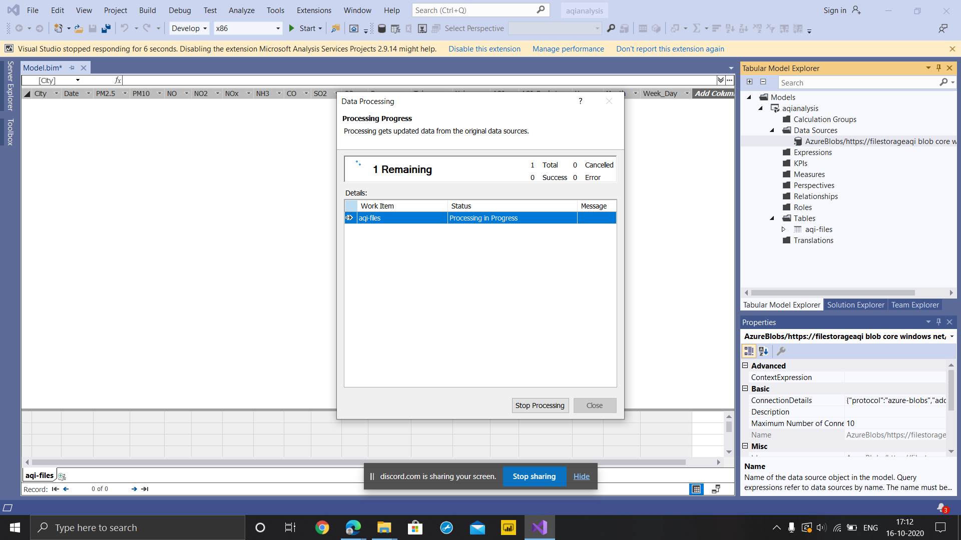

Slide 15
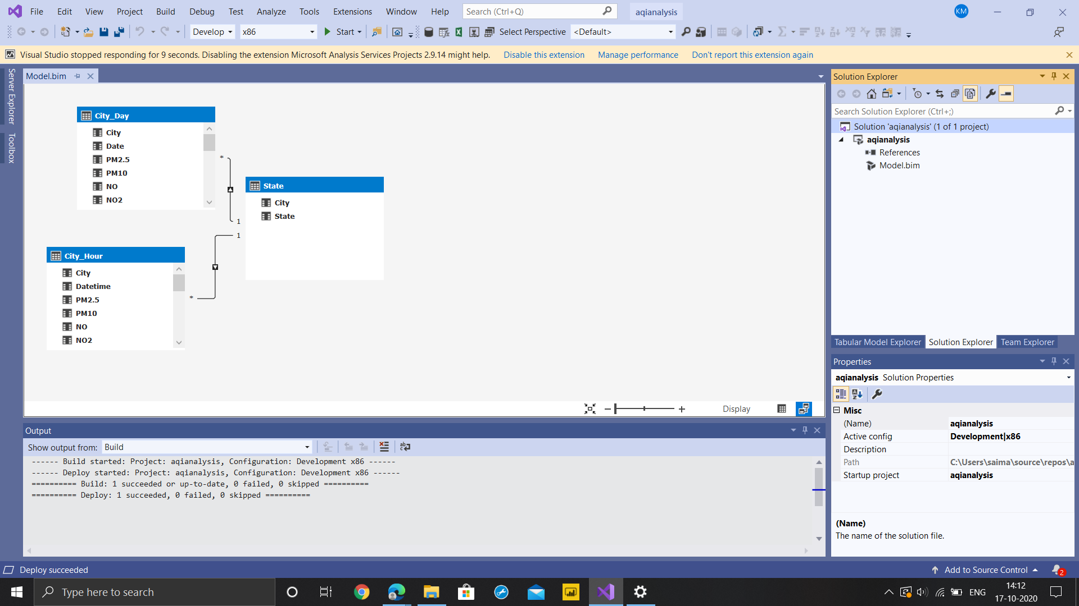

Slide 16
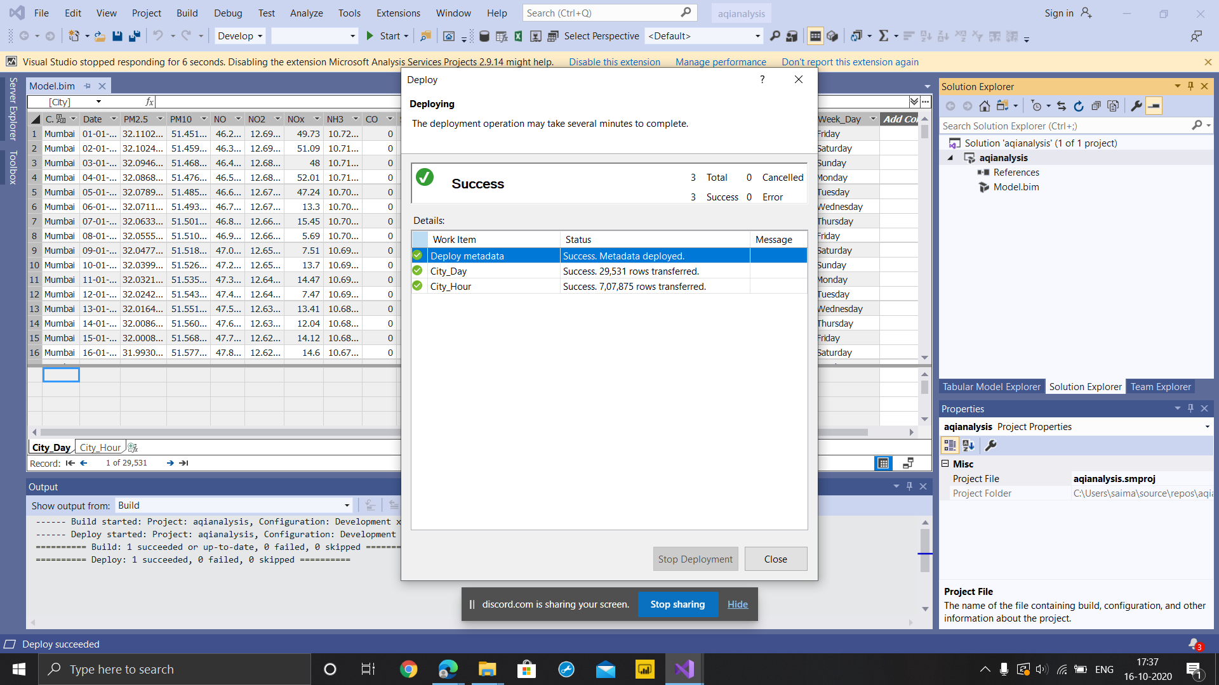

Slide 17
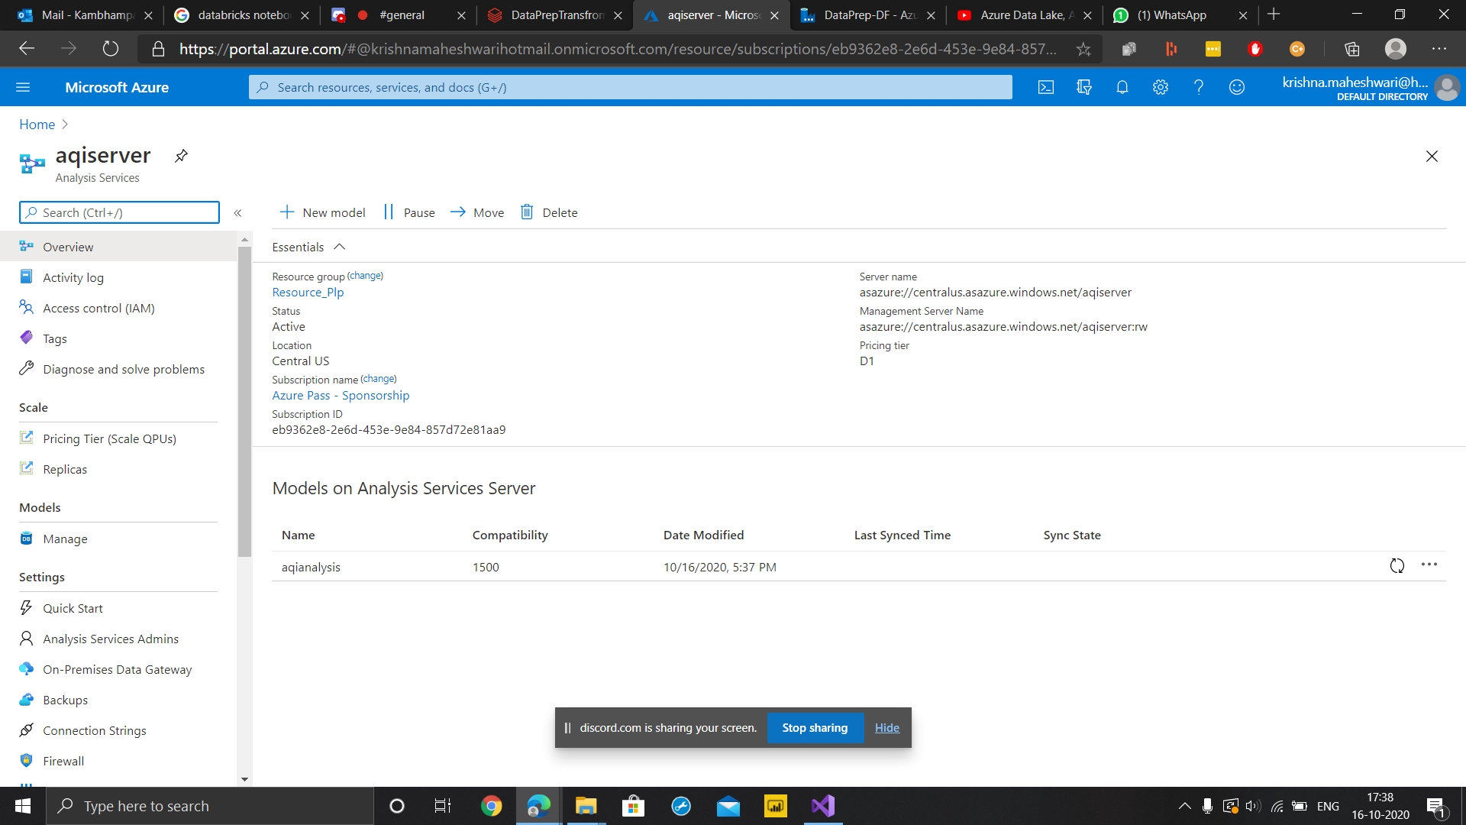

Slide 18
Data Analysis & Reporting
Connecting Power BI With Azure Analysis Service Server
Fetching Data Model From Server & Loading Data
Generating Reports Using Visualizations
Categorising Reports On Location & Time Basis
Covering Various Trends & Comparison Scenarios
Creating Various Slicers With Handled Interaction & Bookmarks
Saving The Report File With “.pbix” Extension

Slide 19
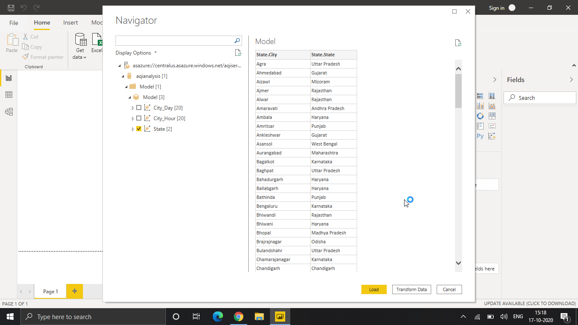

Slide 20
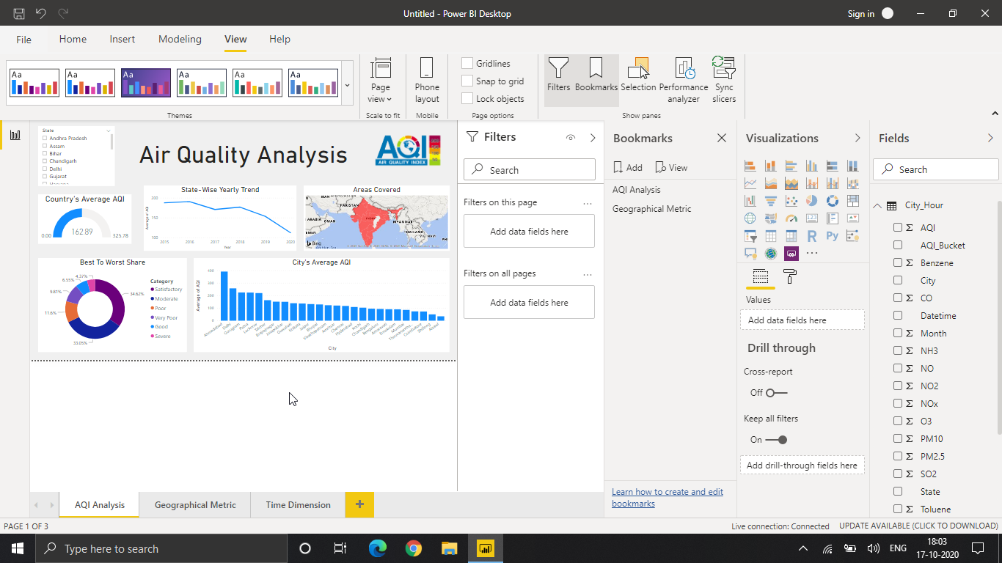

Slide 21
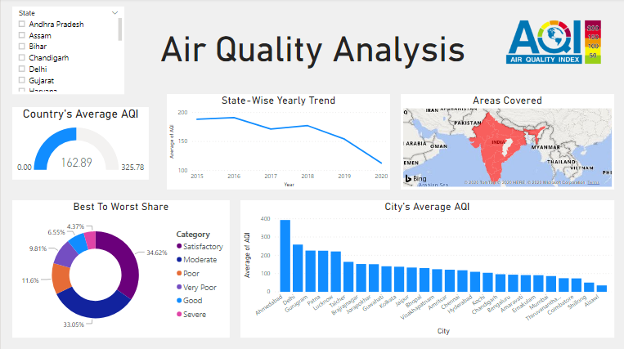

Slide 22
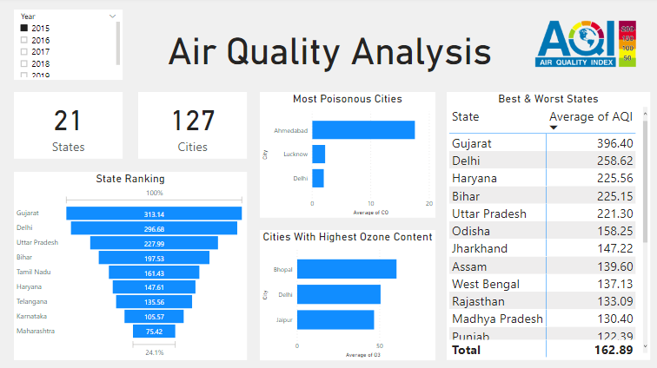

Slide 23
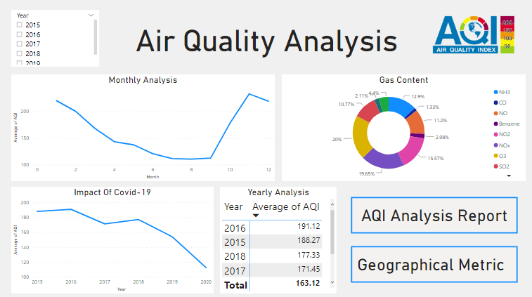

Slide 24
THANK YOU
Kshitiz Bansal

